Slide 1
A Survey of ITP Systems and Their Practical Aspects in Large-Scale Formal Veriﬁcation
Fariba Khan
School of EECS
Oregon State University

Slide 2
Content
Interactive Theorem Proving (ITP) and ITP Systems
Large-Scale Formal Verification using ITP Systems
Practical Aspects of ITP systems in Large-Scale Formal Verification
Challenges in Large-Scale Formal Verification using ITP systems
Efficiency
Maintainability
Methodologies to attain Efficiency and Maintainability
Proactive Approaches
Organization and Adaptability
Reusability
Automation and Portability
Reactive Approaches
Refactoring
Repair
Tooling and IDE Support from ITP Systems
Conclusion

Slide 3
Content
ITP Systems
Large Scale Formal Verification
Challenges
Maintainability
Efficiency
Organization and Adaptability
Reusability
Automation and Portability
Refactoring
Repair
Proactive
Reactive
Solutions

Slide 4
Content
ITP Systems
Large-Scale Formal Verification
Challenges
Maintainability
Efficiency
Organization and Adaptability
Reusability
Automation and Portability
Refactoring
Repair
Proactive
Reactive
Solutions

Slide 5
Content
ITP Systems
Large-Scale Formal Verification
Challenges
Maintainability
Efficiency
Organization and Adaptability
Reusability
Automation and Portability
Refactoring
Repair
Proactive
Reactive
Solutions

Slide 6
Content
ITP Systems
Large Scale Formal Verification
Challenges
Maintainability
Efficiency
Organization and Adaptability
Reusability
Automation and Portability
Refactoring
Repair
Proactive
Reactive
Solutions

Slide 7
Content
ITP Systems
Large Scale Formal Verification
Challenges
Maintainability
Efficiency
Organization and Adaptability
Reusability
Automation and Portability
Refactoring
Repair
Proactive
Reactive
Solutions

Slide 8
Content
ITP Systems
Large Scale Formal Verification
Tooling
IDE support
Challenges
Maintainability
Efficiency
Organization and Adaptability
Reusability
Automation and Portability
Refactoring
Repair
Proactive
Reactive
Solutions

Slide 9
Interactive Theorem Proving (ITP) and ITP Systems
ITP Systems
Large Scale Formal Verification
Challenges
Maintainability
Efficiency
Organization and Adaptability
Reusability
Automation and Portability
Refactoring
Repair
Proactive
Reactive
Solutions

Slide 10
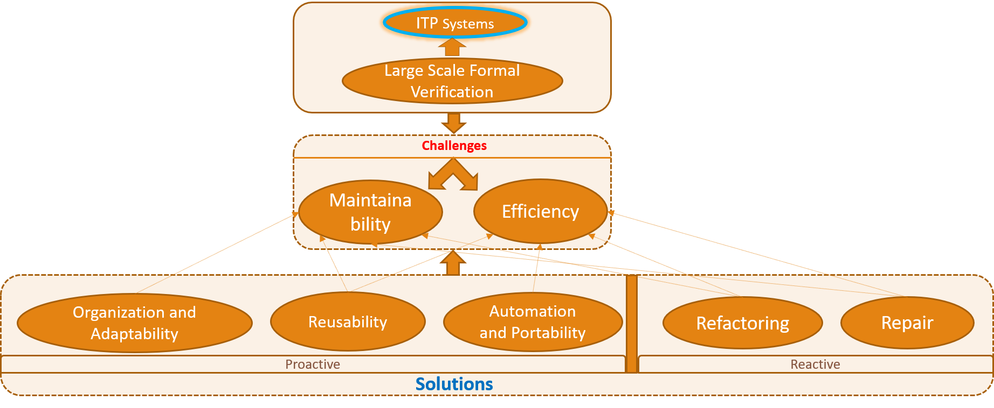
Interactive Theorem Proving (ITP) and ITP Systems
ITP Systems assist human in writing machine-checkable proofs in a formal system of mathematics. Different formal systems of mathematics prompted the development of different ITP systems. Automath by N. de Bruijn is the first attempt in mechanical verification of mathematical proofs that uses Curry-Howard Isomorphism. Curry-Howard isomorphism states a one-to-one correspondence between formal logic and typed model of computation. e.g. natural deduction and simply typed lambda calculus Proofs-as-Programs/Terms Propositions-as-Types Provability in logic becomes type inhabitation problem on the computation part. Curry-Howard isomorphism led to two notable formal systems that can act both as proof systems and typed functional programming languages. Martin-Löf’s Intuitionistic Type Theory Coquand’s Calculus of Constructions

Slide 11
Interactive Theorem Proving (ITP) and ITP Systems
Different variants of these formal systems has been implemented in different present ITP systems such as Coq, Agda, NuPRL. Predicative Martin-Löf’s Intuitionistic Type Theory Extensional variant – NuPRL Intensional variant extended with inductive types – Agda Impredicative Calculus of Inductive Constructions – Coq These ITP systems create an explicit proof terms that can be type checked – de Bruijn criterion. However, in LCF approach by Robin Milner, proofs are built directly from the axioms and inference rules of the logic, thereby, providing soundness by construction. Isabelle, HOL-family ITP systems are successors of LCF. Isabelle is also a logical framework which provides a metalogic to encode any object logic such as Higher Order Logic in Isabelle/HOL, ﬁrst-order Zermelo-Frankel set theory in Isabelle/ZF.

Slide 12
Interactive Theorem Proving (ITP) and ITP Systems (Contd.)
 | Agda | Nuprl | Coq | Isabelle/HOL
Logic | Martin Löf Type Theory with Inductive Types | Martin Löf Type Theory | Calculus of Inductive Constructions | Higher Order Logic
Predicativity | Predicative | Predicative | Partial Impredicative | Predicative
Dependent Types | Yes | Yes | Yes | No
De Bruijn Criterion | Yes | Yes | Yes | No (LCF approach)
Classical (C)/ Intuitionistic (I) | I | I | I | C
Imp. Language | Haskell | Lisp | OCaml | Standard ML

Slide 13
Large-Scale Formal Verification using ITP Systems
ITP Systems
Large Scale Formal Verification
Challenges
Maintainability
Efficiency
Organization and Adaptability
Reusability
Automation and Portability
Refactoring
Repair
Proactive
Reactive
Solutions

Slide 14
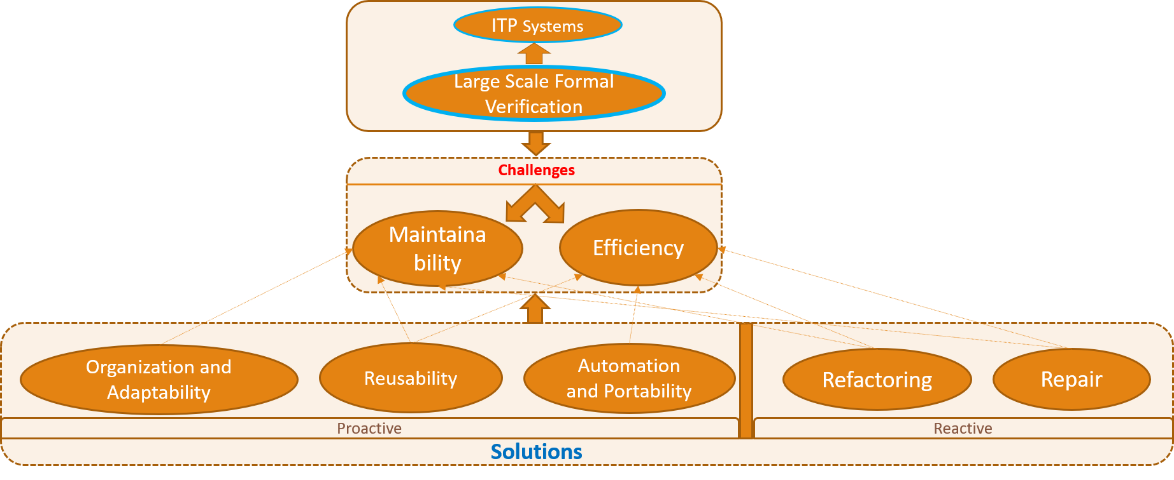
Large-Scale Formal Verification using ITP Systems
Formal verification of systems increase their actual and perceived reliability. Formalization of a system entails identifying system properties that ensure its correctness and then, converting them into formal statements and finding corresponding formal proofs. Large complex systems benefit most from formalization and ITP systems are now being widely used in formal verification of these systems. Some of the notable large-scale formal verifications in ITP systems are CompCert, C compiler verification by Leory [1] ~ 350,000 lines of code in Coq seL4 Operating System Kernel Certification by Klein et. al. [23] ~ 480,000 lines of Isabelle proofs Formal verification of raft consensus protocol by Ongaro and Osterhout [25] ~ 50,000 lines in Coq Consequently, proof developments in ITP systems are getting scaled at an unprecedent rate and researchers are focusing on identifying challenges in large-scale system formalization.

Slide 15
Challenges in Large-Scale Formal Verification using ITP systems
ITP Systems
Large Scale Formal Verification
Challenges
Maintainability
Efficiency
Organization and Adaptability
Reusability
Automation and Portability
Refactoring
Repair
Proactive
Reactive
Solutions

Slide 16
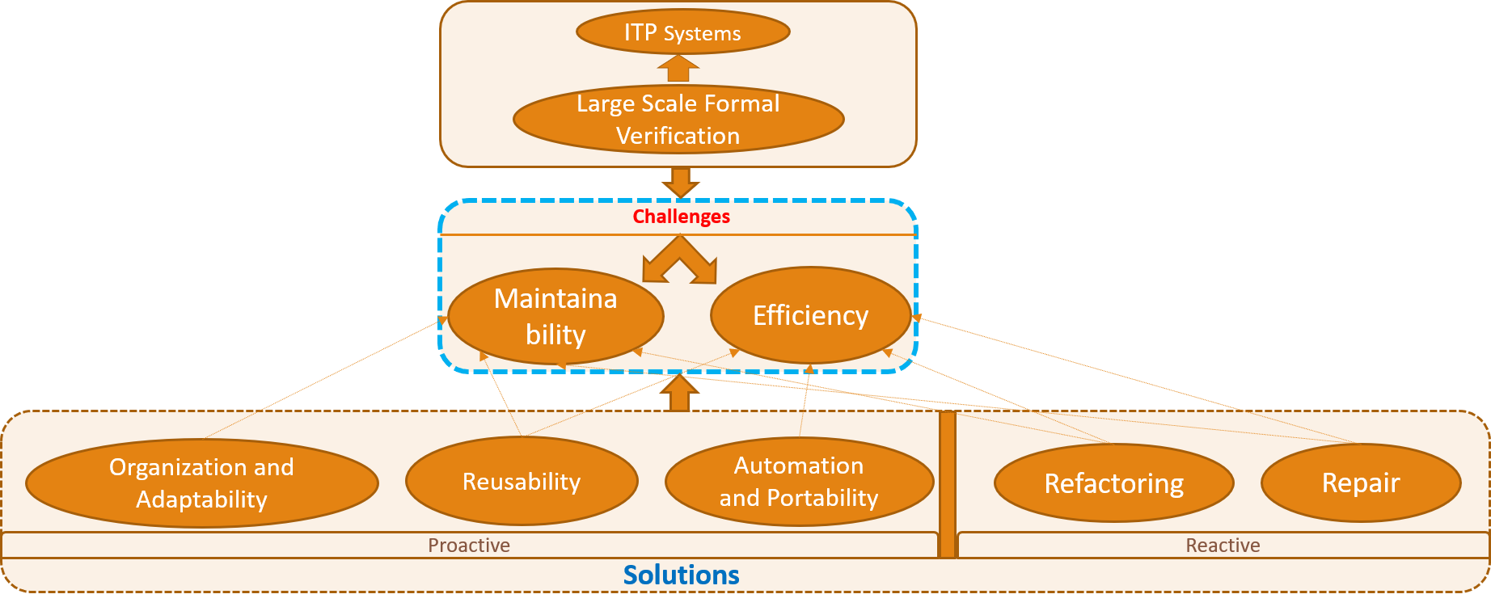
Challenges in Large-Scale Formal Verification using ITP systems
In addition to creating hundreds of thousands of lines of proofs, system verification frequently needs to deal with formalizing properties of complex systems [27]. These verifications often get carried out as part of active evolving projects leading to evolution of proofs due to modification in associated design specifications [26]. Proving properties of complex system once is challenging task and with these large intricating proof scripts needed to be maintained as well, it takes multiple persons years of effort for a single project. Therefore, efficiency of proof developers and maintainability of proofs has been identified as two main challenges in this domain and several works have been done to address them. However, efficiency and maintainability are not two completely unrelated concerns. Usually, techniques to promote maintainability aid in the efficiency of the development as well.

Slide 17
Methodologies to attain Efficiency and Maintainability
ITP Systems
Large Scale Formal Verification
Challenges
Maintainability
Efficiency
Organization and Adaptability
Reusability
Automation and Portability
Refactoring
Repair
Proactive
Reactive
Solutions

Slide 18
Proof Organization and Adaptability
ITP Systems
Large Scale Formal Verification
Challenges
Maintainability
Efficiency
Organization and Adaptability
Reusability
Automation and Portability
Refactoring
Repair
Proactive
Reactive
Solutions

Slide 19
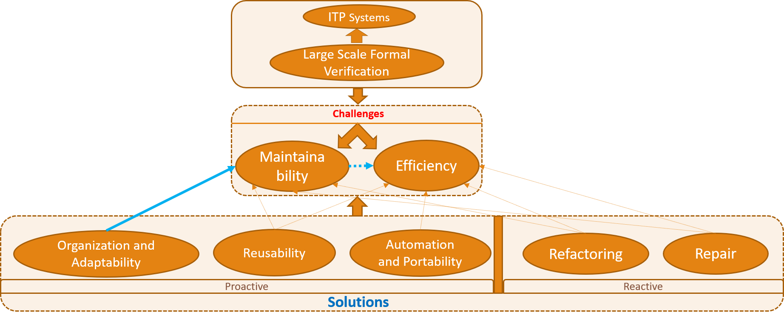
Proof Organization and Adaptability
Proofs that are well organized and adaptable to changes can be maintained efficiently during development. Adaptability implies both robustness and modifiability in the face of changes. These attributes can be attained through following techniques [26, 24, 38] Hierarchical organization of definitions and proofs Information hiding techniques Separation of theorems and proofs through interface Custom Induction Principles Refinement Proofs Custom and general-purpose tactics
Notes:
Adaptability implies both robustness and modifiability in the face changes.

Slide 20
Proof Organization and Adaptability
Proofs that are well organized and adaptable to changes can be maintained efficiently during development. Adaptability implies both robustness and modifiability in the face changes. These attributes can be attained through following techniques [26, 24, 38] Hierarchical organization of definitions and proofs For example, definitions can be refined and organized hierarchically based on underlying systems’ features and their mutual dependencies. In turn, proofs can also be organized hierarchically by packaging proofs dependent on the definitions with the definitions themselves. Information hiding Separation of theorems and proofs through interface Custom Induction Principles Refinement Proofs Custom and general-purpose tactics
Notes:
Cite techniques

Slide 21
Proof Organization and Adaptability
Proofs that are well organized and adaptable to changes can be maintained efficiently during development. Adaptability implies both robustness and modifiability in the face changes. These attributes can be attained through following techniques [26, 24, 38] Hierarchical organization of definitions and proofs Information hiding Hides function and type definitions from the dependents through interfaces Forces dependents to write implementation without these information In turn, definitions can be updated without any change to the dependents However, requires interface lemmas sufficient and necessary to reason about them Separation of theorems and proofs through interface Custom Induction Principles Refinement Proofs Custom and general-purpose tactics
Notes:
Cite techniques

Slide 22
Proof Organization and Adaptability
Proofs that are well organized and adaptable to changes can be maintained efficiently during development. Adaptability implies both robustness and modifiability in the face changes. These attributes can be attained through following techniques [26, 24, 38] Hierarchical organization of definitions and proofs Information hiding Separation of theorems and proofs through interface Places theorems in interfaces and writes proofs as interface implementation Lets dependent proofs to only import the interface containing theorem Thus, allows modification of proofs without triggering recompilation of dependent proofs Leads to faster build time Custom Induction Principles Refinement Proofs Custom and general-purpose tactics
Notes:
Cite techniques

Slide 23
Proof Organization and Adaptability
Proofs that are well organized and easily adaptable to changes can be maintained efficiently during development. Adaptability implies both robustness and modifiability in the face changes. These attributes can be attained through following techniques [26, 24, 38] Hierarchical organization of definitions and proofs Information hiding Separation of theorems and proofs through interface Custom Induction Principles Common inductive reasoning patterns can be factored out into custom induction principles. These principles are proved once and then, used repeatedly throughout the development. Aid in maintainability through better organization and less involved modifiability. Refinement Proofs Custom and general-purpose tactics
Notes:
Cite techniques

Slide 24
Proof Organization and Adaptability
Proofs that are well organized and adaptable to changes can be maintained efficiently during development. Adaptability implies both robustness and modifiability in the face changes. These attributes can be attained through following techniques [26, 24, 38] Hierarchical organization of definitions and proofs Information hiding Separation of theorems and proofs through interface Custom Induction Principles Refinement Proofs Refinement proofs formally establish that properties of a concrete version of a program are contained in the set of properties of its abstract version. Thus, proof development can be broken down into abstract specification capturing system’s high-level behaviors and concrete specification addressing low-level implementation details. Low-level changes don’t affect proofs in the higher-level.
Notes:
Cite techniques

Slide 25
Proof Organization and Adaptability
Proofs that are well organized and adaptable to changes can be maintained efficiently during development. Adaptability implies both robustness and modifiability in the face changes. These attributes can be attained through following techniques [26, 24, 38] Hierarchical organization of definitions and proofs Information hiding Separation of theorems and proofs through interface Custom Induction Principles Refinement Proofs Custom and general-purpose tactics Use of custom and general-purpose tactics make proofs more robust in the face of changes. General purpose tactics, like omega can dispatch a range of similar kind of goals. If modified goal stays within that range, proof remains valid without any maintenance.
Notes:
Cite techniques

Slide 26
Proof Organization and Adaptability
Proofs that are well organized and adaptable to changes can be maintained efficiently during development. Adaptability implies both robustness and modifiability in the face changes. These attributes can be attained through following techniques [26, 24, 38] Hierarchical organization of definitions and proofs Information hiding Separation of theorems and proofs through interface Custom Induction Principles Refinement Proofs Custom and general-purpose tactics Use of custom and general-purpose tactics make proofs more robust in the face of changes Custom tactics can also be written to make proofs more resilient. For example, writing custom tactics to declaratively specify which variable or hypothesis to use instead of using their automatically generated names or ordering aids in robustness.
Notes:
Cite techniques

Slide 27
Proof Reusability
ITP Systems
Large Scale Formal Verification
Challenges
Maintainability
Efficiency
Organization and Adaptability
Reusability
Automation and Portability
Refactoring
Repair
Proactive
Reactive
Solutions

Slide 28
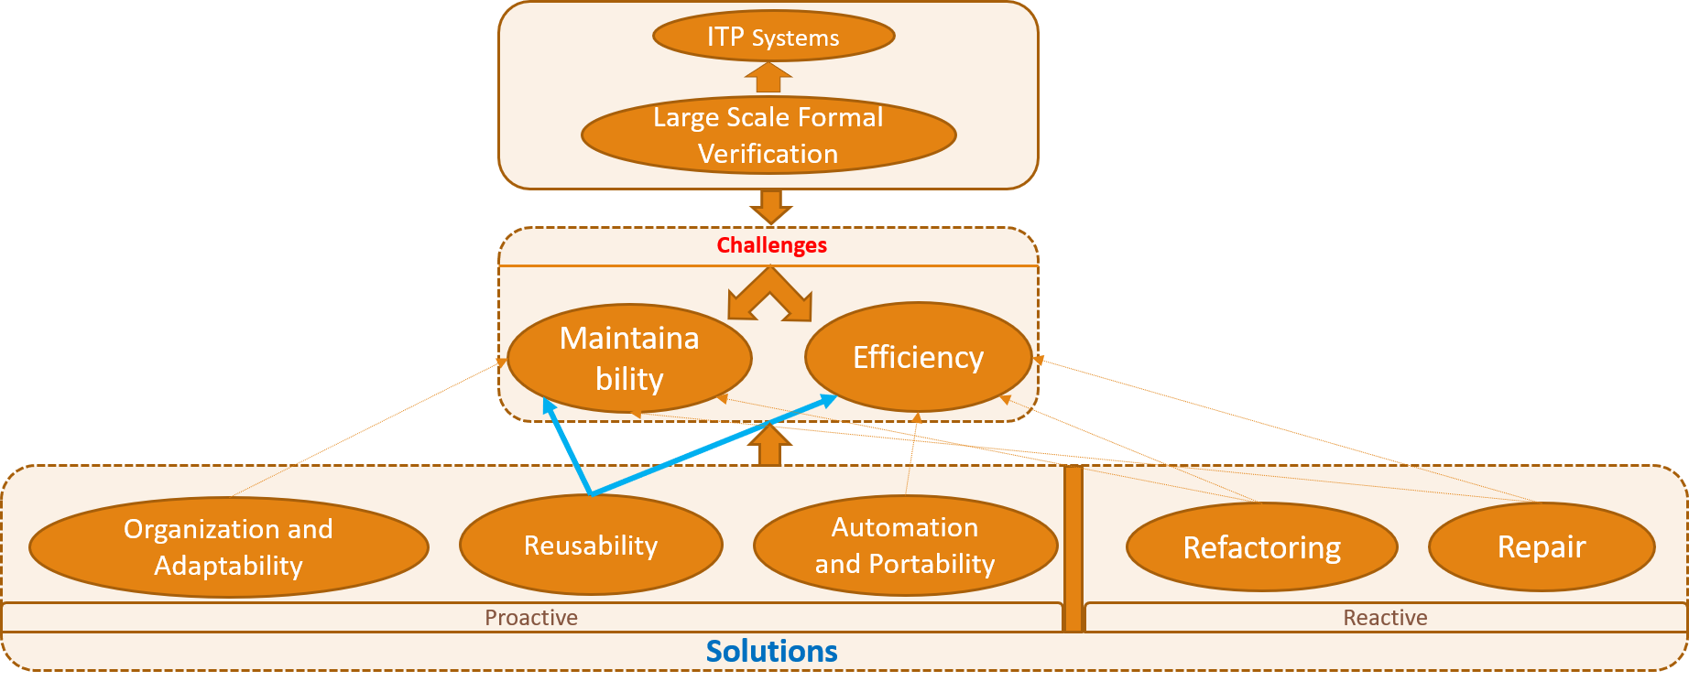
Proof Reusability
Proof reusability addresses both maintainability and efficiency concerns. Maximizing the reuse of existing proved theorems and lemmas reduces work, thereby increases efficiency. Reusable proofs can be maintained in one place while being used throughout. Reusability can be facilitated through any of the following three Proof Term Transformation Proof Script Generalization Type Equivalence Relationship

Slide 29
Proof Reusability
Proof reusability addresses both maintainability and efficiency concerns. Maximizing the reuse of existing proved theorems and lemmas reduces work, thereby increases efficiency. Reusable proofs can be maintained in one place while being used throughout. Reusability can be facilitated through any of the following three Proof Term Transformation In type-theory based ITP systems, each proof is basically a term of the type of its proposition whether it is written as one or converted to one later. Proofs can be generalized by creating an abstract version of their associated terms to reuse them over a range of objects through specialization [39]. Transformation of terms also enable automatic adaption of existing proofs over inductive types when these types are extended with new constructors or parameters . Proof developers only need to fill up the new cases [40]. Mulhern [41] furthers above work by synthesizing repetitive portion of proofs for the new cases as well. only interesting part is left for developers.

Slide 30
Proof Reusability
Proof reusability addresses both maintainability and efficiency concerns. Maximizing the reuse of existing proved theorems and lemmas reduces work, thereby increases efficiency. Reusable proofs can be maintained in one place while being used throughout. Reusability can be facilitated through any of the following three Proof Term Transformation Proof Script Generalization Proof script can also be generalized through parameterization using modules and functors or type classes from ITP systems [31, 29]. These abstraction allows proofs to be reused with appropriate instantiation. Tactic based proofs can also be generalized using metavariables and reused later [44]. Type Equivalence Relationship

Slide 31
Proof Reusability
Proof reusability addresses both maintainability and efficiency concerns. Maximizing the reuse of existing proved theorems and lemmas reduces work, thereby increases efficiency. Reusable proofs can be maintained in one place while being used throughout. Reusability can be facilitated through any of the following three Proof Term Transformation Proof Script Generalization Type Equivalence Relationship Type equivalence relationships promote reuse by allowing functions and proofs, written for one type, to be carried over to an equivalent type. For example, type isomorphism can be included in dependent type theory through rewrite rules thus allowing reuse over objects related through the isomorphism[45]. A more recent mechanism, known as ornaments can be used as a notion on datatypes to derive refined (both annotated and indexed) version of them [47] Thereby, promoting reuse over this relationship between refined and unrefined types.

Slide 32
Proof Reusability
Proof reusability addresses both maintainability and efficiency concerns. Maximizing the reuse of existing proved theorems and lemmas reduces work, thereby increases efficiency. Reusable proofs can be maintained in one place while being used throughout. Reusability can be facilitated through any of the following three Proof Term Transformation Proof Script Generalization Type Equivalence Relationship Univalence axiom in Homotopy Type Theory (HoTT) defines type equivalence for intensional type theory [50] Constructive judgements for univalence [51] are provided in Cubical Type theory and has been extended by Coquand et. al. [52] with higher inductive types letting it to be used in Coq and Agda. In a nutshell, it can be said researchers are finding new ways for entities to be equal that can be exploited to promote reuse. Recent development in HoTT have potential to make breakthrough in this area of research.

Slide 33
Proof Automation and Portability among ITP Systems
ITP Systems
Large Scale Formal Verification
Challenges
Maintainability
Efficiency
Organization and Adaptability
Reusability
Automation and Portability
Refactoring
Repair
Proactive
Reactive
Solutions

Slide 34
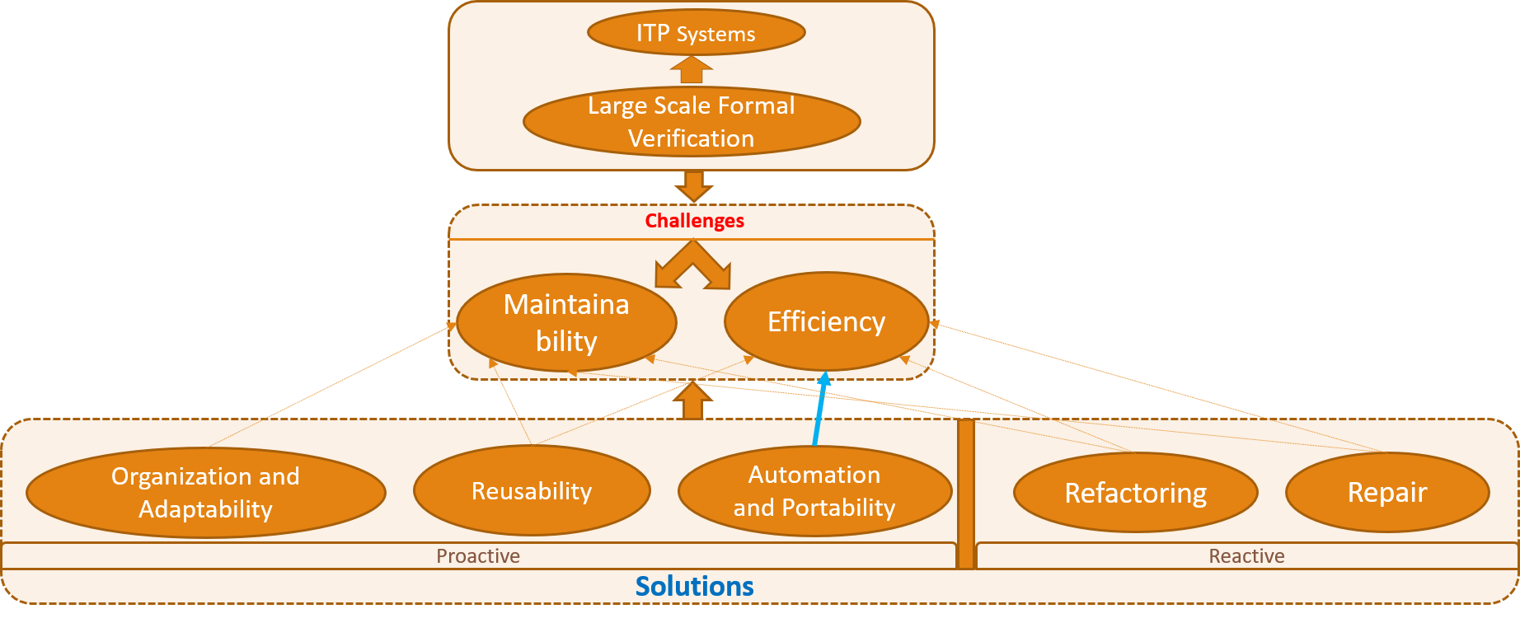
Proof Automation and Portability among ITP Systems
Automation and portability among ITP systems address the efficiency concern of the large-scale development. Interactive theorem proving system combined with automation can amplify human’s ability by taking care of trivial, repetitive and explorative tasks. There are well-developed techniques from automated theorem proving era that can be used in injunction with ITP such as Theory Exploration tools Hammers Portability of proofs among different ITP systems allows use of existing proofs and libraries from one system to another. thereby, reduce duplicative work, increase collaboration, idea transfers among proof engineers. Existing works on proof translation among ITP systems include HOL – Nuprl [66], Isabelle/HOL – HOL Light [70], HOL4, HOL Light – Coq [72, 73].

Slide 35
Proof Automation and Portability among ITP Systems
Automation and portability among ITP systems address the efficiency concern of the large-scale development. Interactive theorem proving system combined with automation can amplify human’s ability by taking care of trivial, repetitive and explorative tasks. There are well-developed techniques from automated theorem proving era that can be used in injunction with ITP such as Theory Exploration tools Hipster [59] in Isabelle/HOL Automatically generate lemmas from a set of data types and functions as well as Discover missing lemmas during proof creation that can prove the current goal Theorema [58] Another tool that supports entire process of mathematical theory exploration. Dramnesc et. al. [57] contains an example work where authors used both Theorema and Coq depending on the need. Hammers

Slide 36
Proof Automation and Portability among ITP Systems
Automation and portability among ITP systems address the efficiency concern of the large-scale development. Interactive theorem proving system combined with automation can amplify human’s ability by taking care of trivial, repetitive and explorative tasks. There are well-developed techniques from automated theorem proving era that can be used in injunction with ITP such as Theory Exploration tools Hammers Truly exploit Automated Theorem Prover (ATP) within ITP systems. For a goal to be proven, they create an ATP problem, call an ATP to solve the problem, finally, if a proof is found, translate it to ITP systems logic so that it can be certified there as well. Examples include CoqHammer[62], Sledgehammer[63], HOL(y)Hammer[64].

Slide 37
Proof Automation and Portability among ITP Systems
Automation and portability among ITP systems address the efficiency concern of the large-scale development. Interactive theorem proving system combined with automation can amplify human’s ability by taking care of trivial, repetitive and explorative tasks. There are well-developed techniques from automated theorem proving era that can be used in injunction with ITP such as Theory Exploration tools Hammers Portability of proofs among different ITP systems allows existing proofs and libraries from one system to be used in another. thereby, reduce duplicative work, increase collaboration, idea transfers among communities of different ITP systems. Existing works on proof translation include HOL – Nuprl [66], Isabelle/HOL – HOL Light [70], HOL4, HOL Light – Coq[72, 73].

Slide 38
Proof Refactoring and Repair
ITP Systems
Large Scale Formal Verification
Challenges
Maintainability
Efficiency
Organization and Adaptability
Reusability
Automation and Portability
Refactoring
Repair
Proactive
Reactive
Solutions

Slide 39
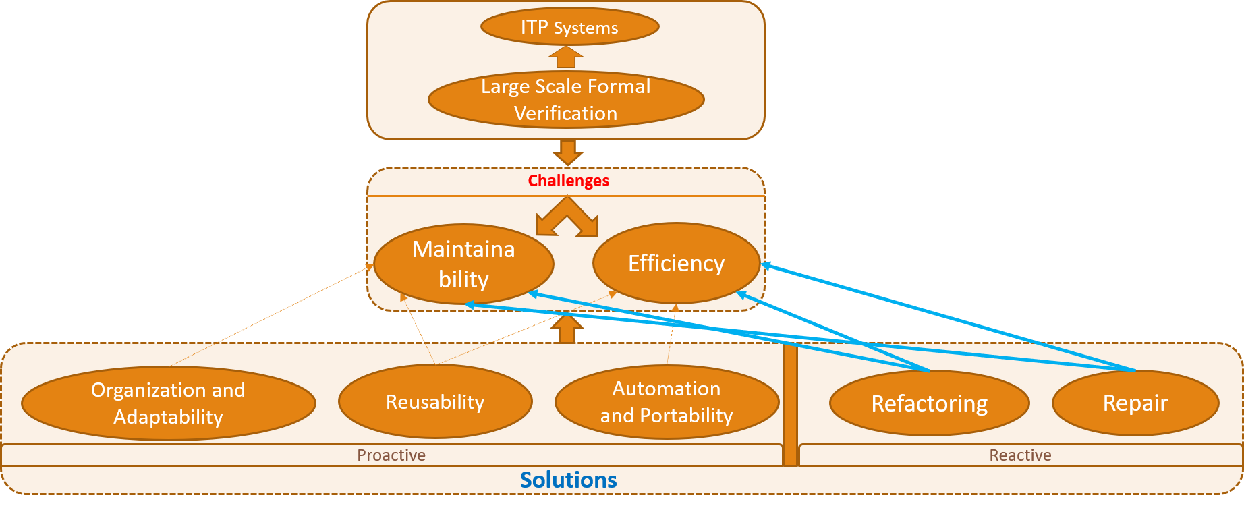
Proof Refactoring and Repair
Proof refactoring can improve maintainability and efficiency of development by transforming proofs that has already been created (Reactive approach). Existing refactoring tools either work on proof scripts or proof terms to achieve such qualities. Proof script refactoring tools include Levity [81] POLAR [82] Tactician [83] Proof term refactoring tools are Chick [79] RefactorAgda [85] Proof repair tool should automatically create patches in response to changes in definitions or theorem specifications and apply them to fix broken proofs due to those changes. Most of these tools are in development phase and have potential to offer more features in future.

Slide 40
Proof Refactoring and Repair
Proof refactoring can improve maintainability and efficiency of development by transforming proofs that has already been created (Reactive approach). Existing refactoring tools either refactor proof scripts or proof terms to achieve such qualities. Proof script refactoring tools include Levity [81] moves general lemmas to optimal position in proof script to maximize their reuse. POLAR [82] Tactician [83] Proof term refactoring tools are Chick [79] RefactorAgda [85] Proof repair tool should automatically create patches in response to changes in definitions or theorem specifications and apply them to fix broken proofs due to those changes.

Slide 41
Proof Refactoring and Repair
Proof refactoring can improve maintainability and efficiency of development by transforming proofs that has already been created (Reactive approach). Existing refactoring tools either refactor proof scripts or proof terms to achieve such qualities. Proof script refactoring tools include Levity [81] POLAR [82] performs refactoring like renaming lemmas/tactics, converting backward proof to forward proof, deleting not used lemmas or tactics from script . extensible Tactician [83] Proof term refactoring tools are Chick [79]

Slide 42
Proof Refactoring and Repair
Proof refactoring can improve maintainability and efficiency of development by transforming proofs that has already been created (Reactive approach). Existing refactoring tools either refactor proof scripts or proof terms to achieve such qualities. Proof script refactoring tools include Levity [81] POLAR [82] Tactician [83] folds sequence of tactics into tacticals and unfolds tactical into interactive steps for debugging. only works with a small subset of tactic-based proofs. Proof term refactoring tools are Chick [79] RefactorAgda [85]

Slide 43
Proof Refactoring and Repair
Proof refactoring can improve maintainability and efficiency of development by transforming proofs that has already been created (Reactive approach). Existing refactoring tools either refactor proof scripts or proof terms to achieve such qualities. Proof script refactoring tools include Levity [81] POLAR [82] Tactician [83] Proof term refactoring tools are Chick [79] takes example of intended refactoring through partially refactored proof script. propagates that throughout by analyzing and transforming associated proof term. can handle insertion, modification, permutation and deletion of subterms. RefactorAgda [85]

Slide 44
Proof Refactoring and Repair
Proof refactoring can improve maintainability and efficiency of development by transforming proofs that has already been created (Reactive approach). Existing refactoring tools either refactor proof scripts or proof terms to achieve such qualities. Proof script refactoring tools include Levity [81] POLAR [82] Tactician [83] Proof term refactoring tools are Chick [79] RefactorAgda [85] also transforms proof terms to attain refactoring such as adding and removing constructors from data types, reordering functions and constructor arguments, function extraction. works for a small subset of Agda.

Slide 45
Proof Refactoring and Repair
Proof refactoring can improve maintainability and efficiency of development by transforming proofs that has already been created (Reactive approach). Existing refactoring tools either refactor proof scripts or proof terms to achieve such qualities. Proof script refactoring tools include Levity [81] POLAR [82] Tactician [83] Proof term refactoring tools are Chick [79] RefactorAgda [85] Proof repair tool should automatically create patches in response to changes in definitions or theorem specifications and apply them to fix broken proofs due to those changes. Coq plugin, PUMPKIN PATCH [87] is a work in progress towards this goal.

Slide 46
Proof Refactoring and Repair
Proof refactoring can improve maintainability and efficiency of development by transforming proofs that has already been created (Reactive approach). Existing refactoring tools either refactor proof scripts or proof terms to achieve such qualities. Proof script refactoring tools include Levity [81] POLAR [82] Tactician [83] Proof term refactoring tools are Chick [79] RefactorAgda [85] Proof repair tool should automatically create patches in response to changes in definitions or theorem specifications and apply them to fix broken proofs due to those changes. Most of these tools are in development phase and have potential to offer more features in future.

Slide 47
Tooling and IDE Support
ITP Systems
Large Scale Formal Verification
Tooling
IDE support
Challenges
Maintainability
Efficiency
Organization and Adaptability
Reusability
Automation and Portability
Refactoring
Repair
Proactive
Reactive
Solutions

Slide 48
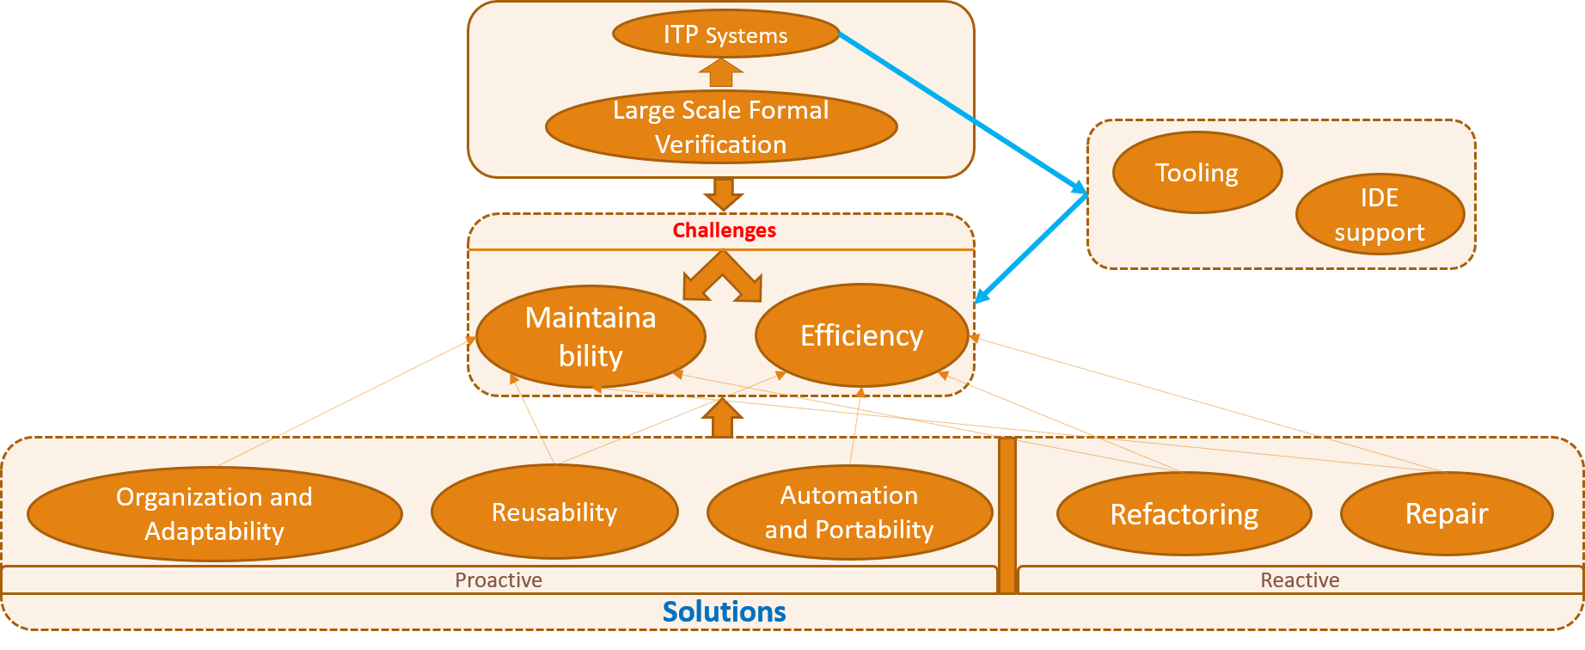
Tooling and IDE Support
Several measures we’ve discussed so far are supported through tooling from different ITP systems. Apart from these tools, ITP systems also provide IDE to aid in proof development. CoqIDE and Proof general are popular IDEs for Coq and Isabelle/jEdit, for Isabelle. Nuprl also comes with its own IDE . However, Agda does not have IDE support at this moment. Some of these IDEs already support project management, asynchronous development to manage large proof development. They can further be improved by integrating better management and debugging tools within them. Specially, debugging is still not that well-supported for tactic-based proofs in ITP systems. Usability analysis can help to identify more proof development needs for better tooling.

Slide 49
Conclusion
This survey explores research on practical aspects of ITP systems to accumulate identified domain-specific challenges in large-scale proof development organize proposed methods to tackle these challenges based on the concerns they address Efficiency and maintainability are two main challenges addressed by researchers. Proofs designed to be well-organized, reusable and easily adaptable address both challenges. Automation and portability among ITP systems also increase efficiency of proof developers. Refactoring and repair tools can play important role in increasing efficiency when proofs need maintenance over time. Several ITP systems provide IDEs, often with support for project management and asynchronous development. These practical aspects are active areas of proof engineering research with promising prospect in proof reusability through type equivalence and maintenance tools.

Slide 50
Bibliography
[1] X. Leroy, “Formal veriﬁcation of a realistic compiler,” Commun. ACM, vol. 52, no. 7, p. 107–115, Jul. 2009. [Online]. Available: https://doi.org/10.1145/1538788.1538814
[2] G. Klein, J. Andronick, K. Elphinstone, T. Murray, T. Sewell, R. Kolanski, and G. Heiser, “Comprehensive formal veriﬁcation of an os microkernel,” ACM Transactions on Computer Systems (TOCS), vol. 32, 02 2014.
[3] D. Ongaro and J. Ousterhout, “In search of an understandable consensus algorithm,” in Proceedings of the 2014 USENIX Conference on USENIX Annual Technical Conference, ser. USENIX ATC’14. USA: USENIX Association, 2014, p. 305–320.
[4]R.Gu,Z.Shao,H.Chen,X.Wu,J.Kim,V.Sjöberg,andD.Costanzo,“Certikos: An extensible earchitecture for building certiﬁed concurrent os kernels,” in Proceedings of the 12th USENIX Conference onOperatingSystemsDesignandImplementation,ser.OSDI’16. USA:USENIXAssociation,2016, p. 653–669.
[5] D. Woos, J. R. Wilcox, S. Anton, Z. Tatlock, M. D. Ernst, and T. Anderson, “Planning for change in a formal veriﬁcation of the raft consensus protocol,” in Proceedings of the 5th ACM SIGPLAN Conference on Certiﬁed Programs and Proofs, ser. CPP 2016. New York, NY, USA: Association for Computing Machinery, 2016, p. 154–165. [Online]. Available: https://doi.org/10.1145/2854065.2854081

Slide 51
Bibliography

